Slide 1
Employee Data Analysis using Excel
STUDENT NAME: MEENA.B
REGISTER NO:422200885
DEPARTMENT:INFORMATION SYSTEM OF MANGEMENT
COLLEGE: SHRI KRISHNASWAMY COLLEGE FOR WOMENS

Slide 2
PROJECT TITLE TRENDS WITH EXCEL CHARTS

Slide 3


AGENDA
Problem Statement
Project Overview
End Users
Our Solution and Proposition
Dataset Description
Modelling Approach
Results and Discussion
Conclusion
3/21/2024 Annual Review

Slide 4

PROBLEM STATEMENT To create an Excel-based tool that leverages various types of charts to analyze and visualize trends in employee performance data. The goal is to enable HR managers and team leaders to detect patterns, monitor performance changes over time, and make informed decisions based on visual insights. Requirements: Data Collection and Preparation: Data Sources: Collect historical performance data, including metrics such as sales figures, project completion rates, customer feedback scores, and attendance records. Data Structure: Organize data in Excel with clear columns for employee IDs, names, performance metrics, dates, and other relevant categories.

Slide 5

PROJECT OVERVIEW The project involves creating an Excel workbook that integrates multiple types of charts to track and visualize trends in employee performance metrics over time. The tool will be used to identify patterns, monitor changes, and compare performance across different periods and group: Dashboard Creation: Integration: Develop a dashboard that consolidates multiple charts and visualizations into a single, interactive view. Interactivity: Include features such as slicers and dropdown menus to filter data by time period, department, or employee. Visual Clarity: Ensure charts are clearly labeled with titles, legends, and explanatory notes for easy interpretation.
.

Slide 6

WHO ARE THE END USERS? HR Managers: Role: Oversee overall employee performance, conduct performance reviews, and make decisions regarding promotions, raises, and development needs. Needs: Tools to monitor and evaluate performance trends, identify high and low performers, and make data-driven decisions. Team Leaders/Supervisors: Role: Manage day-to-day operations of their teams, track team performance, and provide feedback and support to team members. needs: Insights into team performance trends, comparison of individual performance, and identification of areas for team improvement.

Slide 7

OUR SOLUTION AND ITS VALUE PROPOSITION Data Integration: A centralized Excel workbook to collect and organize performance data from multiple sources, including sales figures, project completion rates, customer feedback, and attendance. Trend Analysis Charts: A suite of chart types, including line charts, column charts, bar charts, area charts, and heat maps, to represent performance trends over time. These charts enable users to visualize changes, compare periods, and detect patterns. Interactive Dashboard: A user-friendly dashboard that consolidates various charts and visualizations into a single view, with interactive elements like slicers and dropdown menus to filter data by time period, department, or employee. Interactive Dashboard: A user-friendly dashboard that consolidates various charts and visualizations into a single view, with interactive elements like slicers and dropdown menus to filter data by time period, department, or employee.

Slide 8
Dataset Description Dataset Components 1.1. Employee Information Employee ID: A unique identifier for each employee (e.g., E001, E002). Employee Name: Full name of the employee (e.g., Jane Doe, John Smith). Department: The department or team the employee belongs to (e.g., Sales, Marketing). Role/Position: The employee’s job title or role (e.g., Sales Manager, Marketing Specialist).

Slide 9

THE "WOW" IN OUR SOLUTION Data Visualization Best Practices Trend: Clear, effective visual storytelling. Tip: Choose the right chart type for your data (e.g., line charts for trends, bar charts for comparisons). Avoid clutter by focusing on the key insights and simplifying your design.
3/21/2024 Annual Review

Slide 10
MODELLING
Date | Employee Name | Attendance Status | Hours Worked
2024-08-01 | John Doe | Present | 8
2024-08-01 | Jane Smith | Absent | 0
2024-08-02 | John Doe | Late | 7
2024-08-02 | Jane Smith | Present | 8

Slide 11
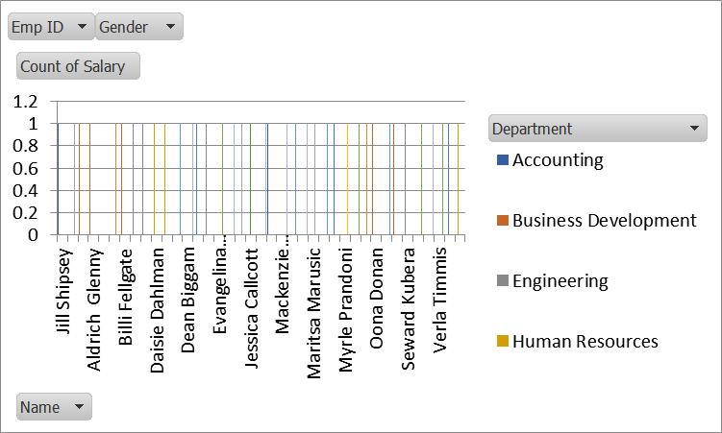
RESULTS

Slide 12
Conclusion Visualizing employee attendance trends using Excel charts provides powerful insights into attendance patterns, employee behavior, and organizational trends. Here’s a summary of how to effectively leverage Excel charts to analyze and present attendance data:

